Slide 1
NYPD Shootings 2006-2022
Apeksha ingole, Samuel klein, madeline riley

Slide 2
Project overview
Data from the NYPD of shootings from 2006-2022
Broken down into three categories; shootings, locations, demographics
This data can help police identify where shootings might occur and who is most likely to be a victim
Objective is to show the analysis of the shooting data with data visualization using the Plotly library without the use of d3.js, Java, or Matplotlib

Slide 3
Data joining
Raw data was stored in the Postgresql data base and a schema was created with three tables
Raw data was imported into the three respective tables
Postgresql data base was connected to a Jupyter Notebook via magic sql and psycogp2
All analysis done on Jupyter Notebook

Slide 4
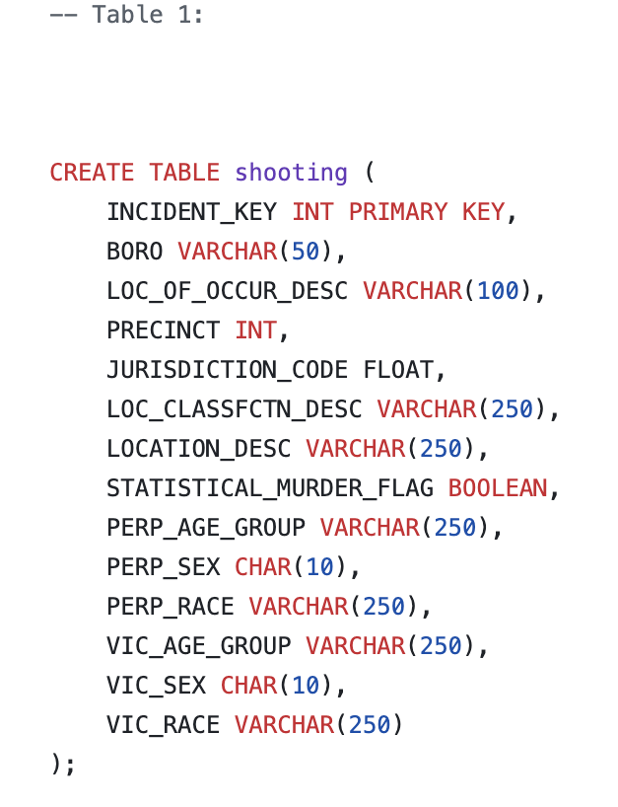
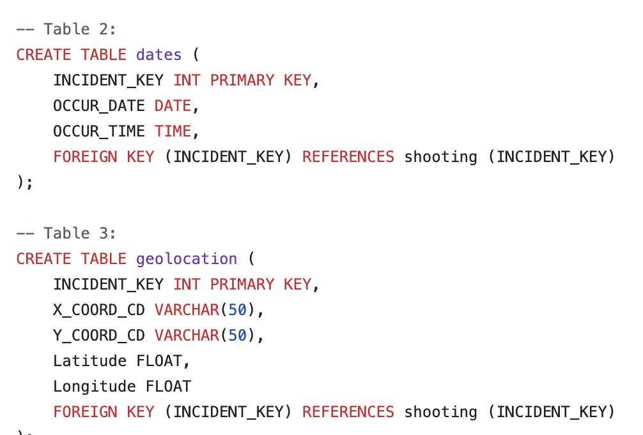
schema

Slide 5
plotly
Plotly was created to satisfy the demand for interactive data
Some pros are
Very interactive
Wide range of charts/graphs
Easy to customize
Drawbacks
Slow run time with large datasets

Slide 6
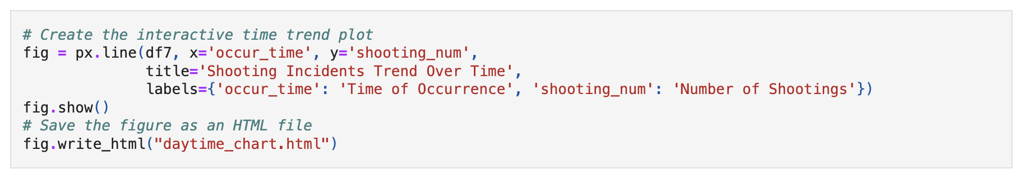
Html code

Slide 7
shootings

Slide 8
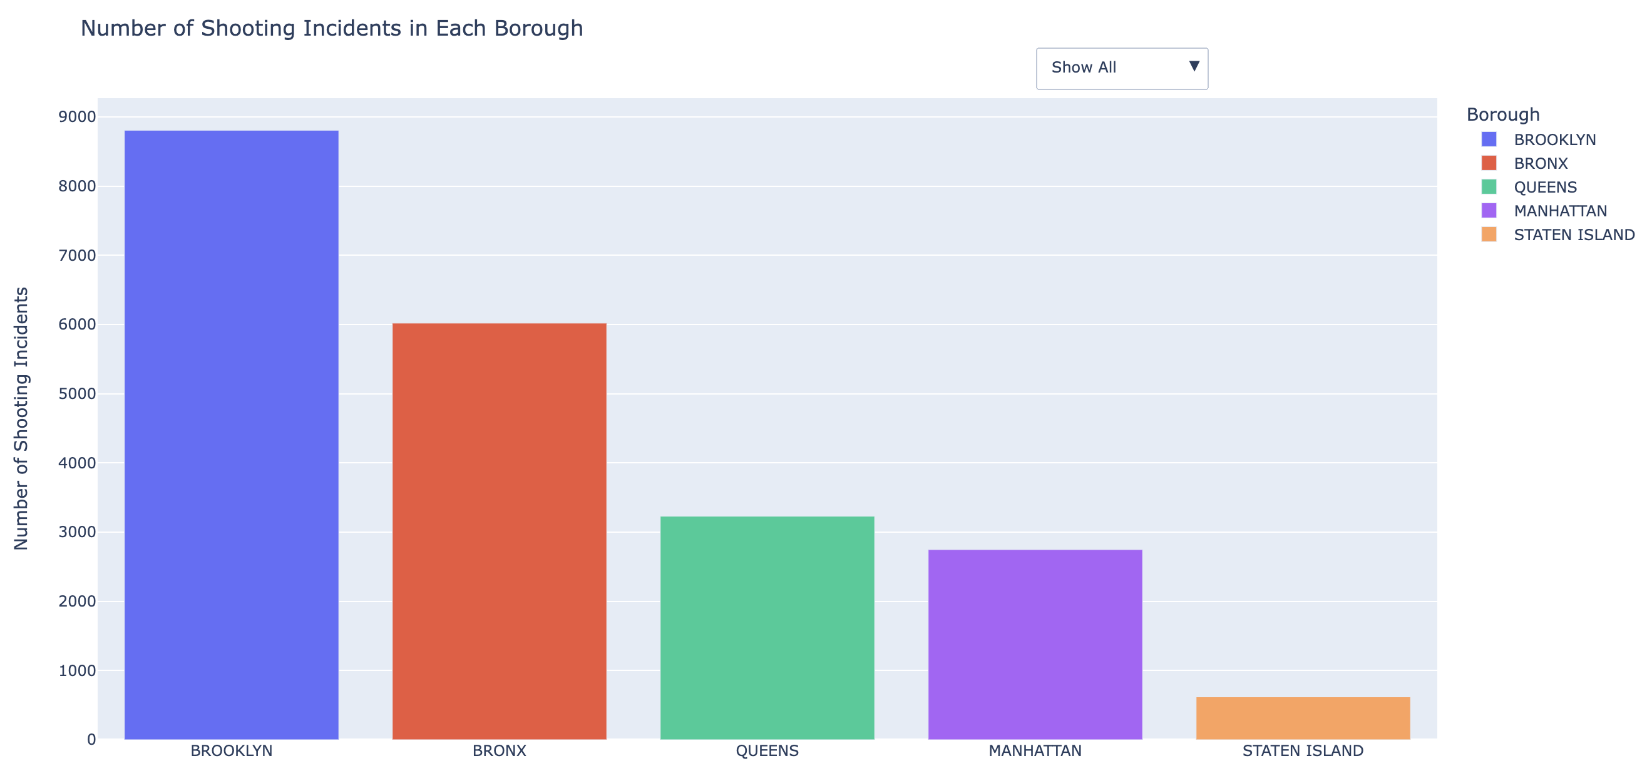
Shootings by borough

Slide 9
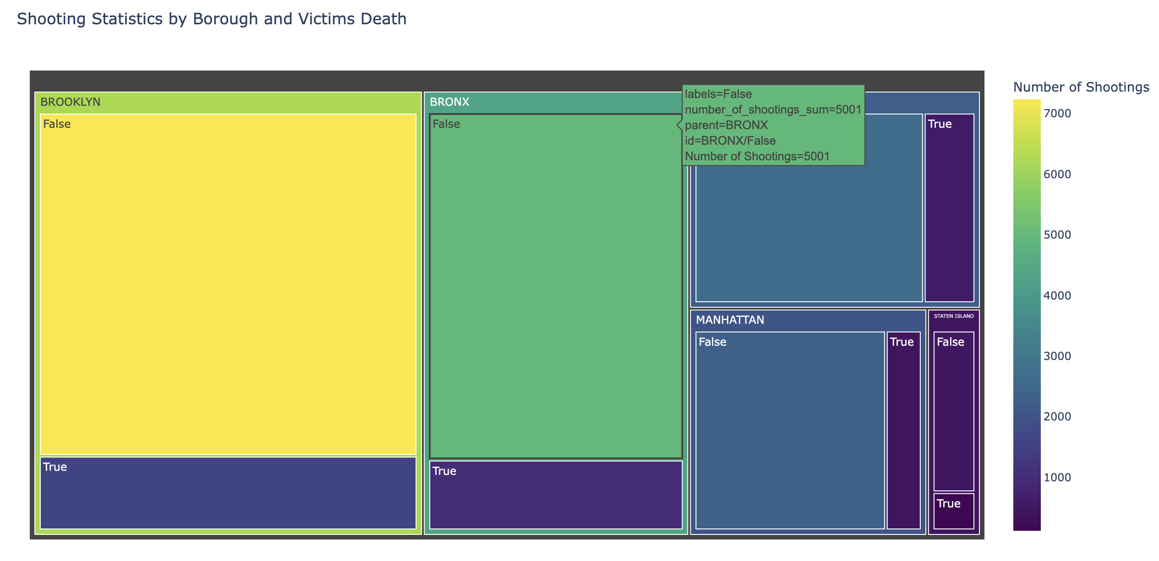
Shootings by borough

Slide 10
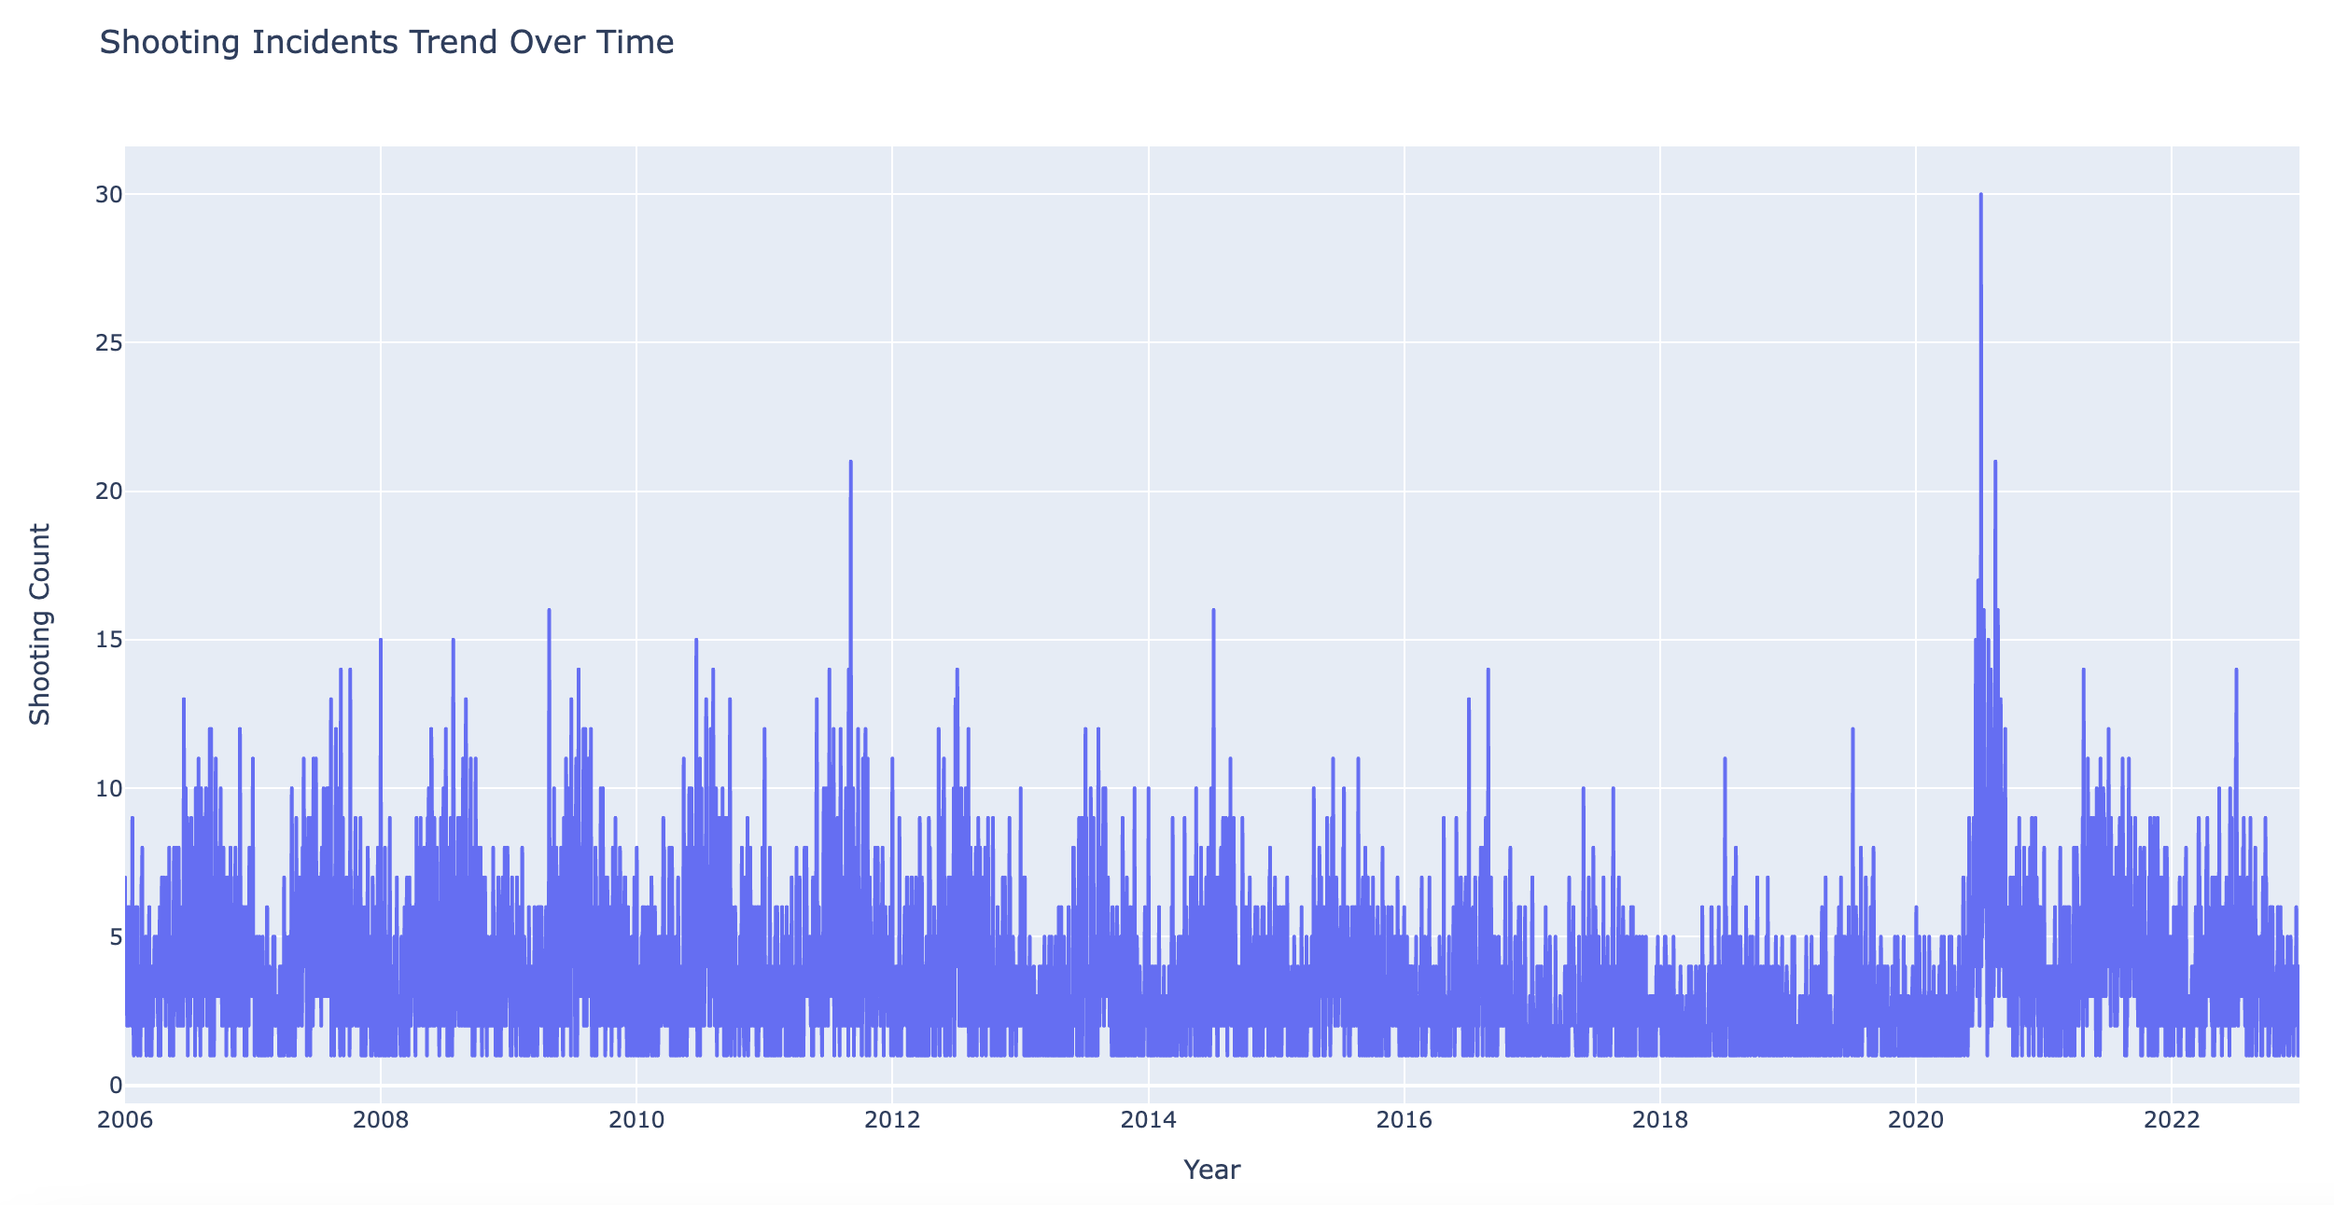
Shooting incidents over time

Slide 11
demographics

Slide 12
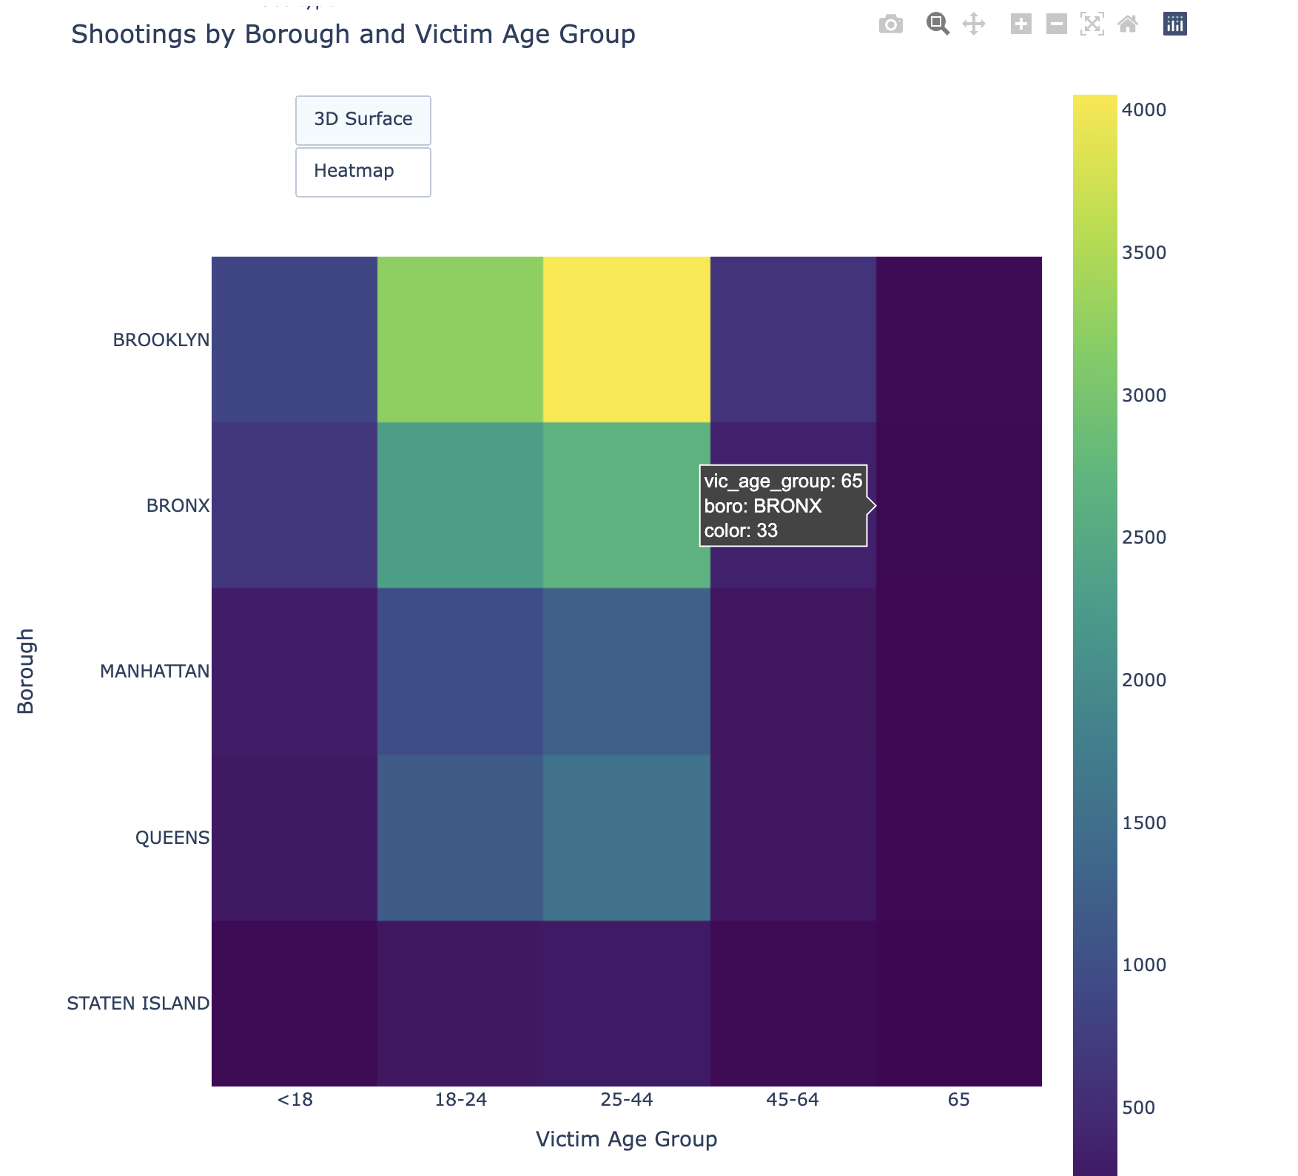
Shootings by borough and age

Slide 13
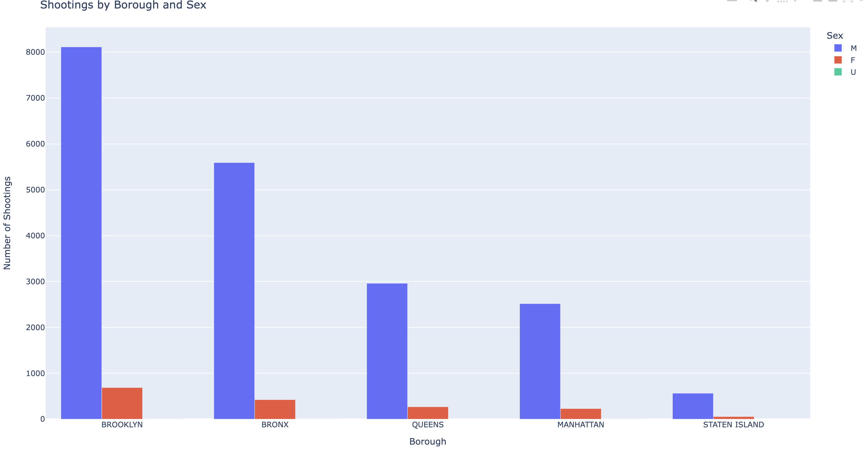
Shootings by borough and sex

Slide 14
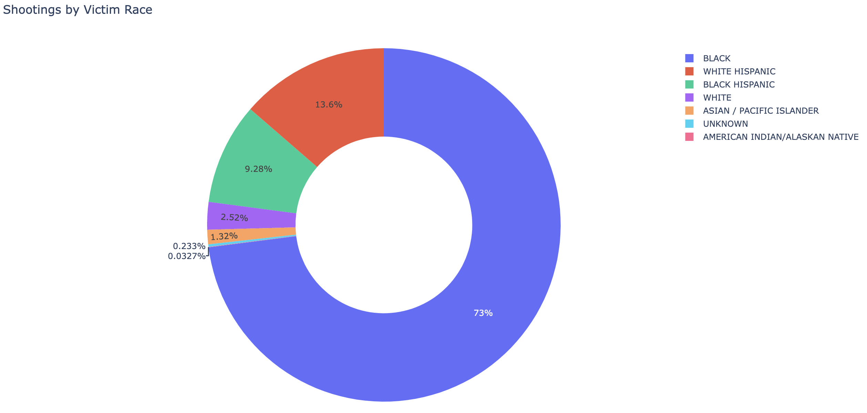
Shooting victim by race

Slide 15
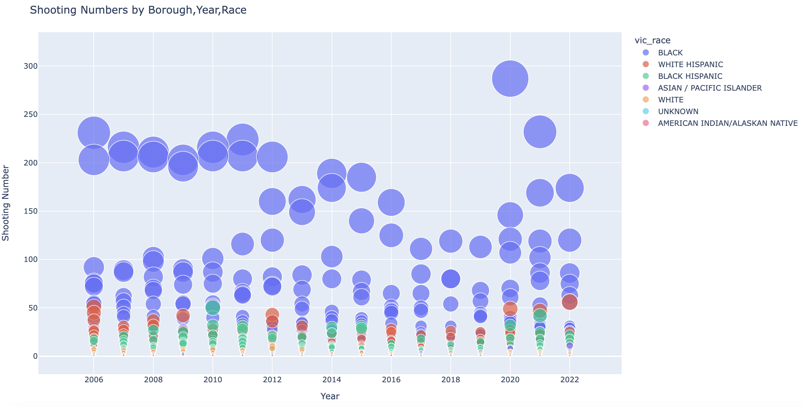
Shooting by borough by race

Slide 16
Location and time

Slide 17
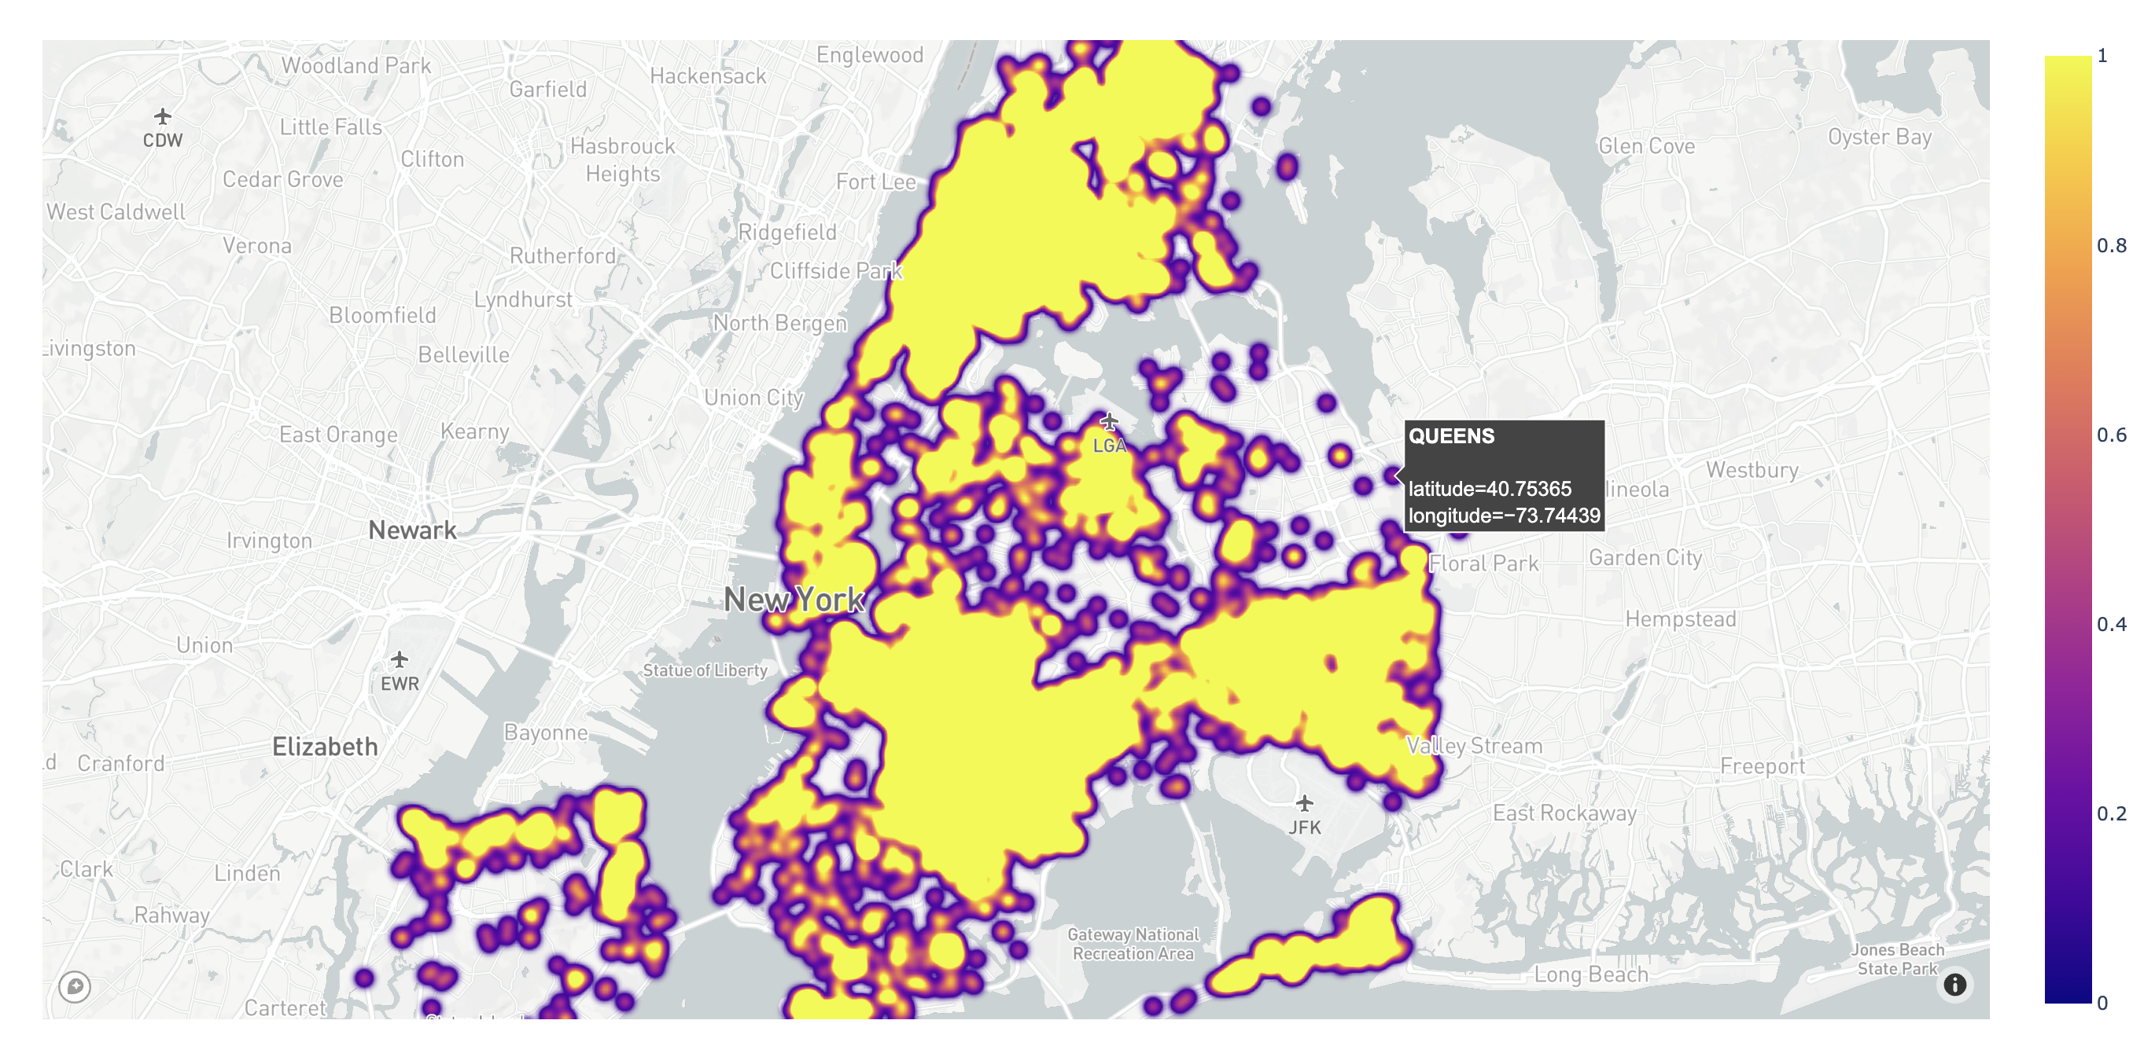
Heatmap of location

Slide 18
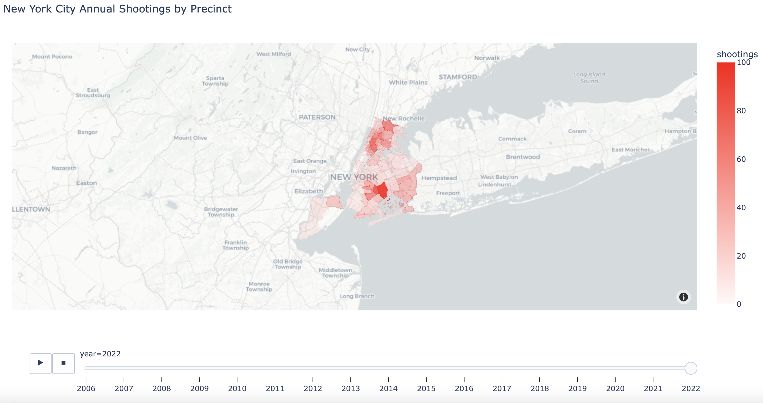
Shooting by precinct

Slide 19
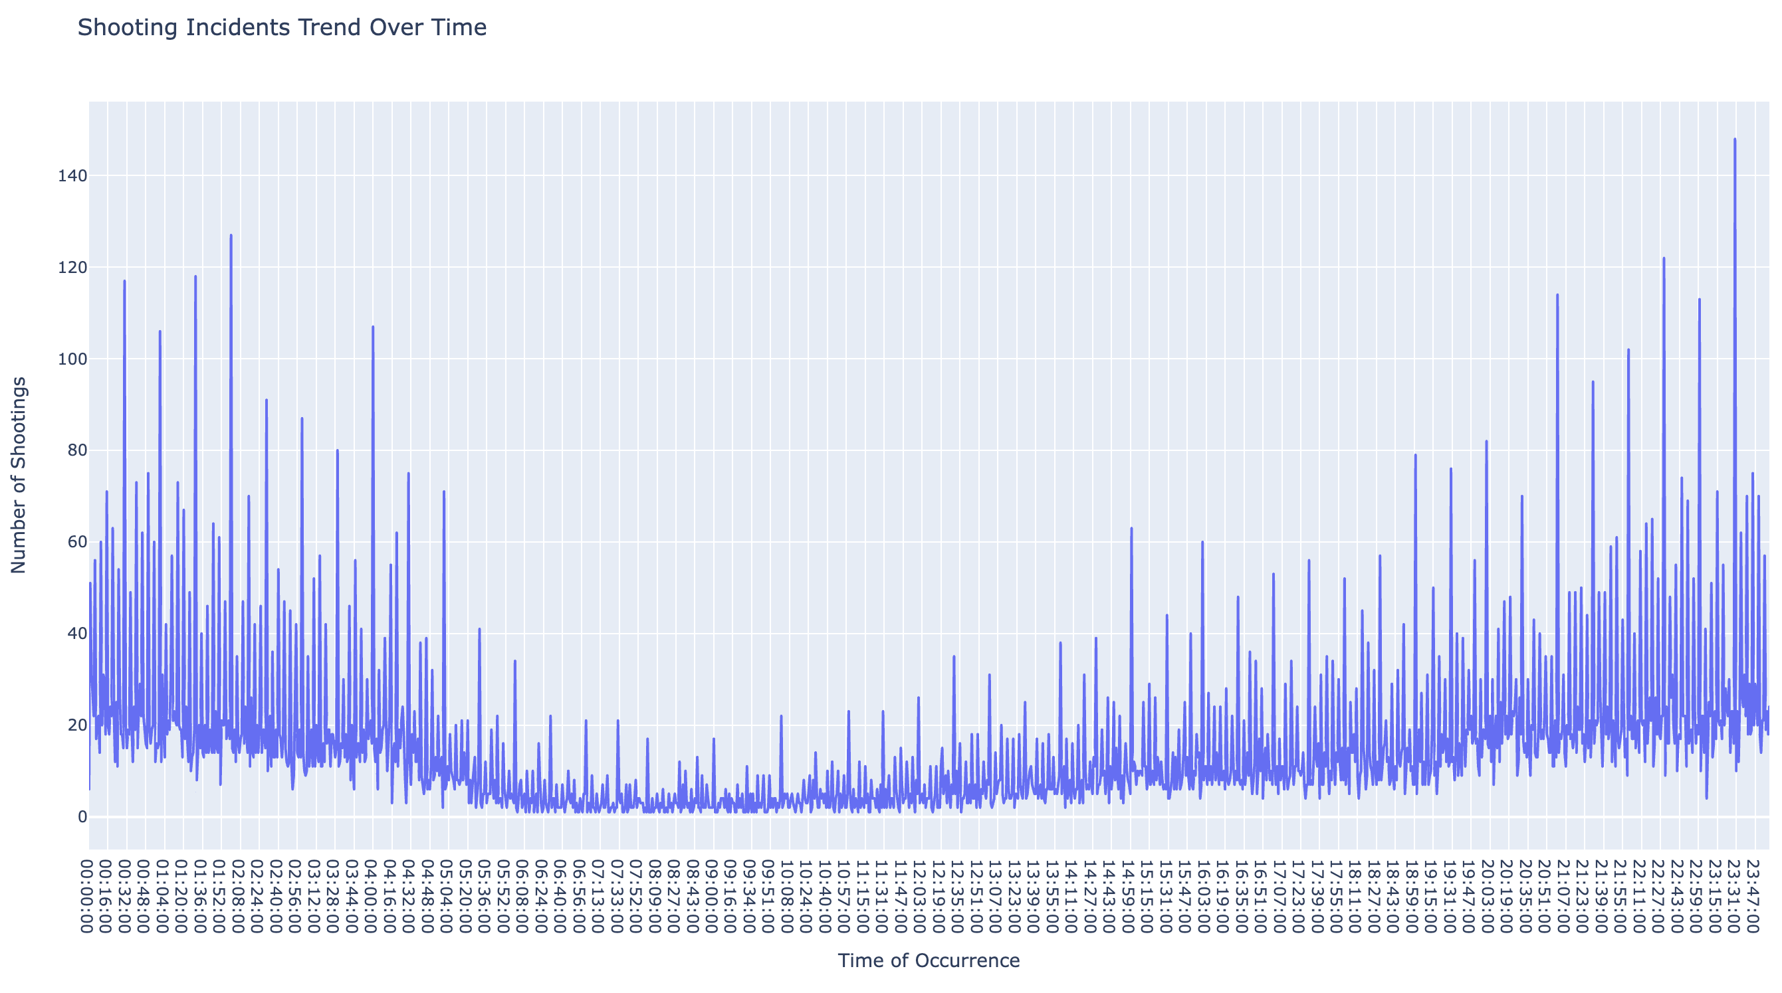
Shooting incidents time of day

Slide 20
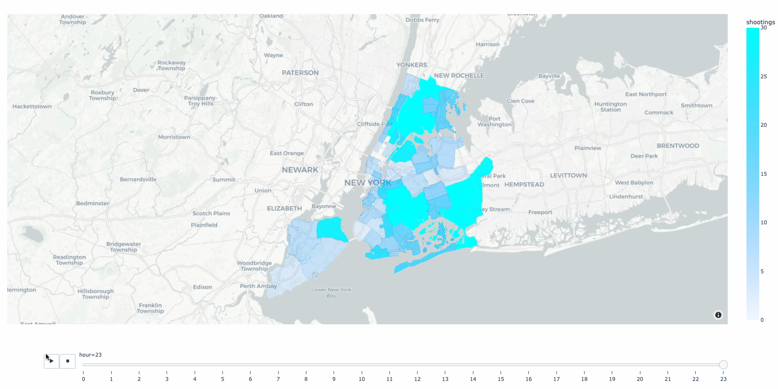
Shooting incidents time of day

Slide 21
Resources
https://catalog.data.gov/dataset/nypd-shooting-incident-data-historic
https://stackoverflow.com/questions/66242946/how-to-get-hour-month-from-timestamp-in-postgresql
https://stackoverflow.com/questions/76464207/how-to-create-heatmap-from-pandas-dataframe-with-annotated-values-in-percentage
https://data.cityofnewyork.us/City-Government/Borough-Boundaries/tqmj-j8zm
https://data.cityofnewyork.us/Public-Safety/Police-Precincts/78dh-3ptz
https://plotly.com/python/
https://farhanfaiyaz17.medium.com/matplotlib-vs-plotly-express-the-ultimate-python-data-visualization-brawl-8cb7d15ba41d

